Slide 1
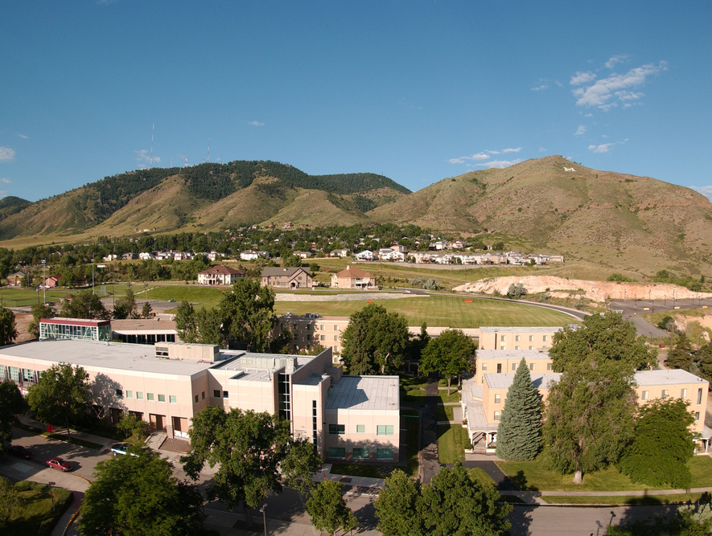
Colorado School of Mines
Computer Vision
Professor William Hoff
Dept of Computer Science
http://inside.mines.edu/~whoff/

Slide 2
Homography Transforms
Part 1

Slide 3
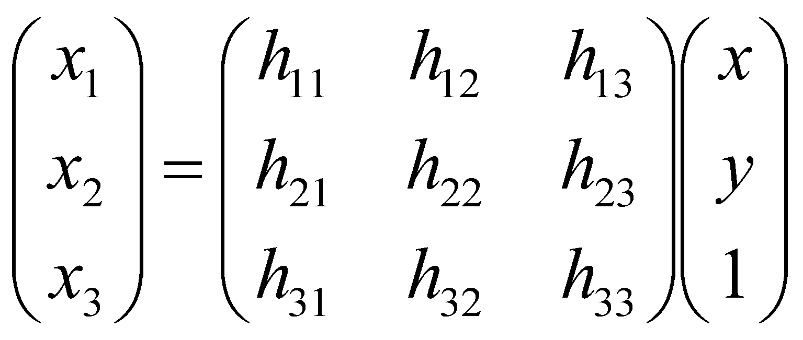

Homography (Projective Transform)
Most general type of linear 2D-2D transform
It is particularly useful in computer vision
A homography maps points from the projection of one plane to the projection of another plane
Homogeneous points: you need to divide by the 3rd element

Slide 4
Applications
Rotating camera
You can generate an image as it would be seen if the camera had rotated in place
Viewing a plane from another viewpoint
You can generate an image of a planar surface, as if it would be seen from another viewpoint

Slide 5
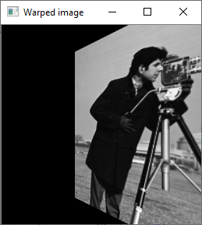
Application: Rotating camera
Given an image of a scene, create another image as if it were taken with the camera at the same position, but rotated in place
Image is from https://www.bogotobogo.com/Matlab/images/MATLAB_DEMO_IMAGES

Slide 6
A rotating camera
P
Let point P be defined in camera #1’s coordinate system. Then
Also
If there is only rotation from camera #1 to camera #2, then
and
C₂
C₁
The 3x3 matrix KRK⁻¹ is a projective transform (homography) from image 1 to image 2

Slide 7
Example
Create the image as if the camera had rotated 30 degrees
Assume we know the camera calibration matrix K
# Read image. img = cv2.imread("cameraman.tif", cv2.COLOR_BGR2GRAY) cv2.imshow("Input image", img) # Define the camera instrinsic matrix K. K = np.array([ (128, 0, 128), (0, 128, 128), (0, 0, 1) ]) # Say we have a rotation about the camera's y axis. ay = math.radians(30.0) cy = math.cos(ay) sy = math.sin(ay) R_1_2 = np.array([[cy, 0, sy], [0, 1, 0], [-sy, 0, cy]]) # This is the projective transform (homography) from image 1 to image 2 Kinv = np.linalg.inv(K) H_1_2 = K @ R_1_2 @ Kinv

Slide 8
Example (continued)
Now, warp the image using the computed homography
We can do it using “for loops”, or use OpenCV’s function “warpPerspective()”
img_warped = cv2.warpPerspective(img, H_1_2, dsize=img.shape) cv2.imshow("Warped image", img_warped)

Slide 9
Good application: Creating an “orthophoto”
An “orthophoto” is an aerial photograph geometrically corrected such that the scale is uniform
Like a map, an orthophotograph can be used to measure true distances
Essentially, we have an image taken by a camera at some off-axis angle, and want to transform it as if it were taken looking straight down
We assume that the scene is planar
The image we have
The image we want

Slide 10
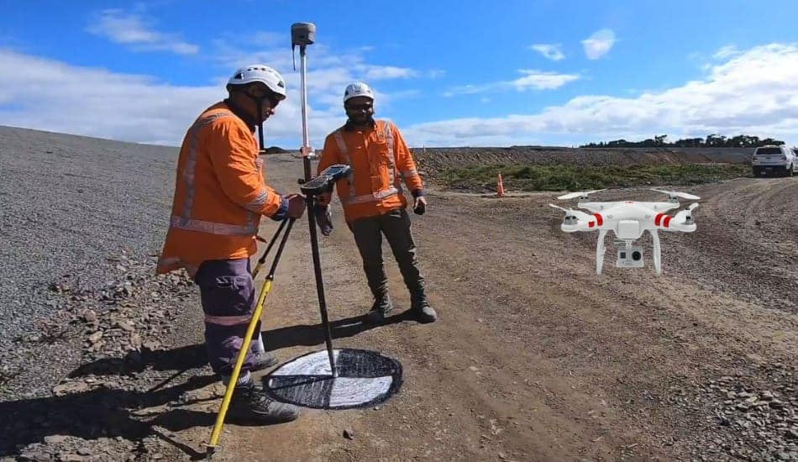
Control points
We pick some known “control points” in the input image, and specify where those points should appear in the output image
For example we could measure their actual positions in the world, and then set our output image scale (e.g., one pixel = one inch)

Slide 11
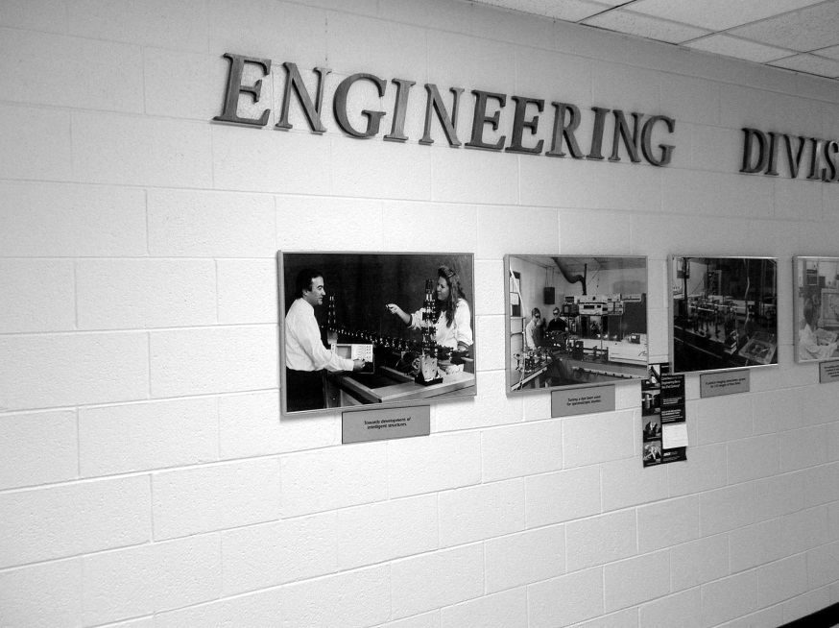
Example
Transform the image as if it were taken from a camera perpendicular to the wall
For control points, we use four brick corners that define a rectangle of known size
The rectangle is 8 bricks high and 13 bricks wide
Each brick is about 23 cm, so rectangle is 8*23=184 cm high and 13*23=299 cm wide
We’ll specify the corresponding rectangle in the output image
Use scale of 1 cm = 1 pixel
Put upper left corner at 0,0
Input image
Output image (orthophoto)
Pixel location (x,y):
389, 127;
1964, 347;
419, 1674;
1983, 1325;
Pixel location (x,y):
0 0;
299 0;
0 184;
299 184;

Slide 12
Useful OpenCV functions
findHomography
Given two sets of control points, estimate the homography transform using least squares fitting
H,_ = cv2.findHomography(src_pts, dst_pts)
warpPerspective
Warp an image using homography matrix created by findHomography”
# width,height is the desired output image size
warped = cv2.warpPerspective(img, H, (width,height))

Slide 13
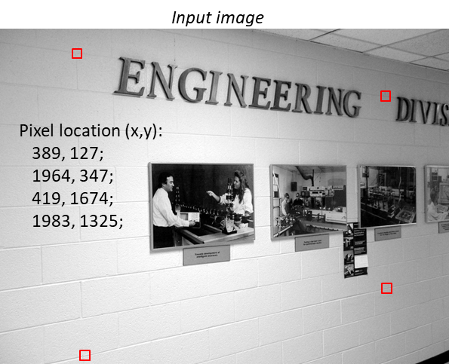
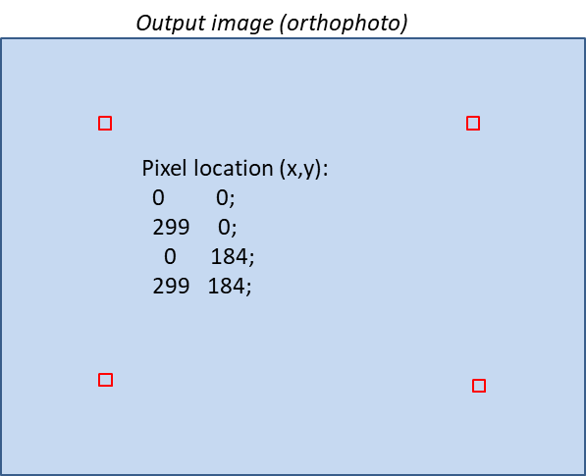
Step 1: Find homography
Find homography that transforms points from the input image to an “orthophoto”
Use four pairs of corresponding points
bgr_image1 = cv2.imread("wall1.jpg")
# Manually pick four (x,y) points on this image and enter below.
pts1 = np.array([[389,127], [1964,347], [419,1674], [1983,1325]])
# Display points on image to verify correct location.
bgr_display = bgr_image1.copy()
for x,y in pts1:
cv2.drawMarker(
img=bgr_display, position=(x,y),
color=(255, 0, 0), markerType=cv2.MARKER_DIAMOND,
thickness=3)
cv2.namedWindow("Image1", cv2.WINDOW_NORMAL)
cv2.imshow("Image1", bgr_display)
cv2.waitKey(0)
# Specify the corresponding points in the output orthophoto image.
pts1_ortho = np.array([[0,0], [299,0], [0,184], [299,184]])
# Find the homography to map the input image to the orthophoto image.
H1, _ = cv2.findHomography(srcPoints=pts1, dstPoints=pts1_ortho)
print(H)

Slide 14
Step 2: Warp image
Warp the image using the estimated homography
We need to provide the desired size of the output image. We have two choices:
Manual method: just guess a large size, and check if the warped image fits into that size
Automatic method: calculate a size that will contain the entire transformed image
Manual method:
output_width = 500
output_height = 500
# Warp the image to the orthophoto.
bgr_ortho = cv2.warpPerspective(bgr_image1, H1, (output_width, output_height))

Slide 15
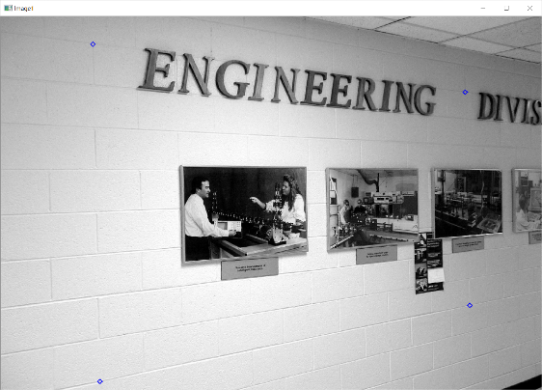
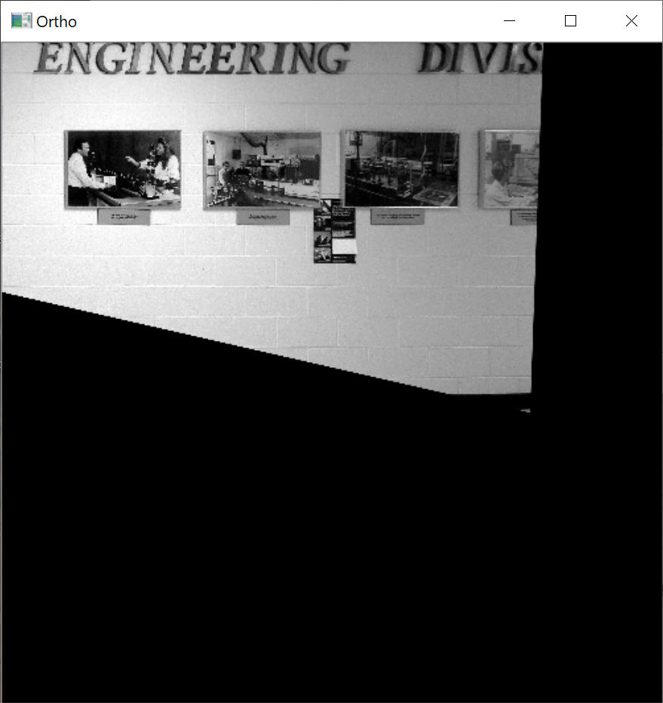
Result: Output warped image
Original image
Notes:
Output mage is too big … you could try a smaller size
Some pixels are cut off on top and left … you could offset the destination points down and right
Orthophoto image

Slide 16
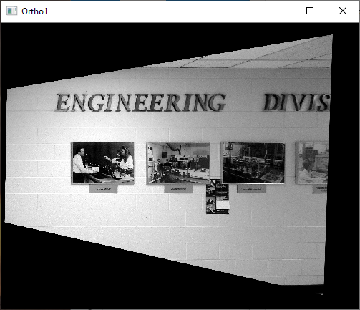
Adjust output size and point positions
Offset destination points down and right
pts1_ortho[:,0] += 50 # Add x offset
pts1_ortho[:,1] += 100 # Add y offset
Use a smaller size for the output image
output_width = 500
output_height = 400
Now all the pixels from the source image fit into the output warped image

Slide 17
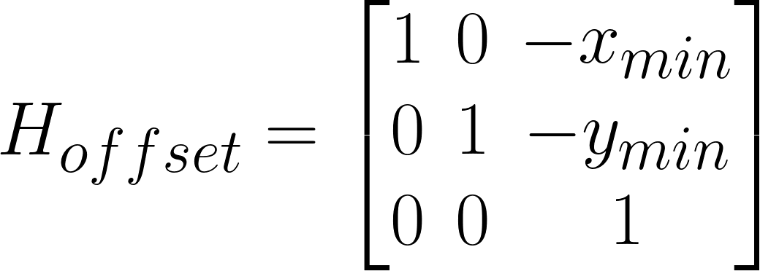
Automatic method to calculate output size
Transform the four corners of the input image to the output, and see where they go
Find the minimum and maximum (x,y) values
Set the output size accordingly:
output_width = xmax - xmin
output_height = ymax - ymin
Apply an offset to the homography so that the left top corner is mapped to (0,0) in the output
H ← H * H_{offset}
where

